Slide 1

Weather Prediction Analysis
Presented by:
K Guruprasad
Mithun Kumar

Slide 2
INTRODUCTION
Weather prediction is essential for sectors like agriculture, transportation, and disaster management.
This project uses historical weather data and machine learning to forecast conditions like temperature, humidity, and precipitation.
It involves data collection, preprocessing, and model development to improve forecast accuracy.
The goal is to show how data analytics can enhance weather predictions and help with decision-making in various industries.

Slide 3

ABOUT DATASET
The dataset is sourced from Kaggle, includes columns that are specific to weather.
The columns consists of the following details:
Precipitation: Measures the amount of rainfall or other precipitation (mm or inches), used to determine if conditions are wet (rain, drizzle, or snow).
Temp_Max: Records the highest temperature for a specific period (usually daily), helping to identify extreme heat or cold, influencing weather conditions like snow or sun.
Temp_Min: Records the lowest temperature of the period, aiding in detecting cold conditions (snow, frost, or fog).
Wind: Represents the wind speed (km/h or mph), impacting weather like fog or storms.

Slide 4

OBJECTIVES
To explore and understand the weather dataset.
To perform data pre-processing, including handling missing values and outliers.
Predict weather conditions (drizzle, rain, sun, snow, fog) using historical weather data.
Use features like precipitation, maximum and minimum temperature, and wind speed.
Apply machine learning techniques to build an accurate weather prediction model.
Analyze the relationship between weather features and conditions.
Improve forecast accuracy to assist in decision-making across various sectors.

Slide 5
METHODOLOGY
Data Collection: The dataset will be sourced from Kaggle, ensuring it is well-documented and reliable.
Database Connectivity: There is a connection object that connects to the MySQL database and is used to insert data from a CSV file into the database via SQL queries in Python Script itself.
Exploratory Data Analysis (EDA): Handle missing data using imputation techniques, Summarize the dataset using descriptive statistics and Create visualizations (e.g., count plots, line plots, pair plot, cat plot and scatterplot) to understand feature distributions and interactions.
Modelling: Split the dataset into training and testing subsets. Train various models and assess their performance using metrics such as accuracy. Optimize the parameters to enhance model performance.
Evaluation and Interpretation: Compare model performances and select the best-performing model. Interpret results to comprehend the impact of different specifications on weather.
Visualization: Generate visual representations of findings to support conclusions.

Slide 6
TOOLS AND TECHNOLOGIES
Programming Language: Python
Libraries: Pandas, NumPy, Matplotlib, Seaborn
IDE: Jupyter Notebook or any Python-compatible IDE
Data Source: Kaggle dataset (Weather Prediction Dataset)
Database: MySQL

Slide 7
EXPLORATORY DATA ANALYSIS (EDA)
Importing Libraries: Import essential libraries for data manipulation and visualization.
Loading Dataset: Load the dataset containing anonymized features and transaction classes.
Basic Exploration: Use head(), tail(), shape, and info() to explore dataset structure and summary.
Checking Missing Values: Identify potential missing data issues with isnull().sum().
Descriptive Statistics: Obtain statistics like mean and quartiles with describe().
Identifying Duplicates: Check for duplicate transactions using duplicated().any().
Analyzing Class Distribution: Assess class balance with groupby('Class').mean().

Slide 8
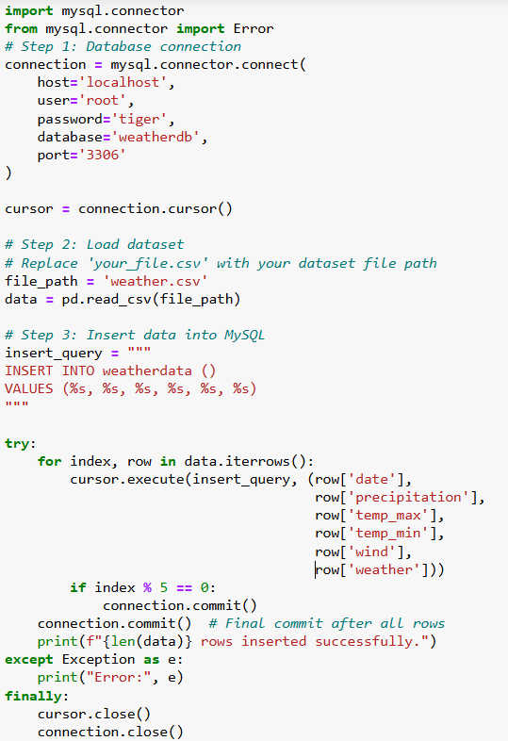
DATABASE CONNECTIVITY
There is a connection object that connects to the MySQL database and is used to insert data from a CSV file into the database via SQL queries in Python Script itself.
It is necessary to specify the host, user, password, database name and port number.

Slide 9
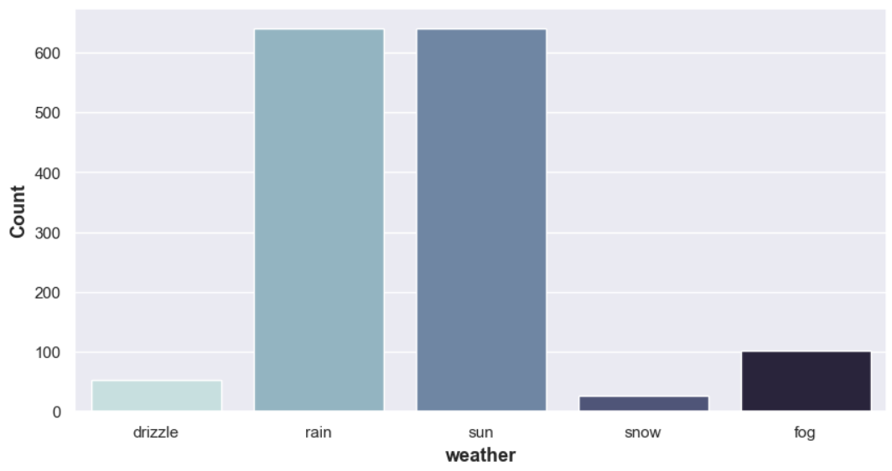
DATA VISUALIZATION
Count Plot: The count plot shows the distribution of different weather types in your dataset, indicating how frequently each weather condition occurs. The height of each bar represents the count of occurrences for each weather type.

Slide 10
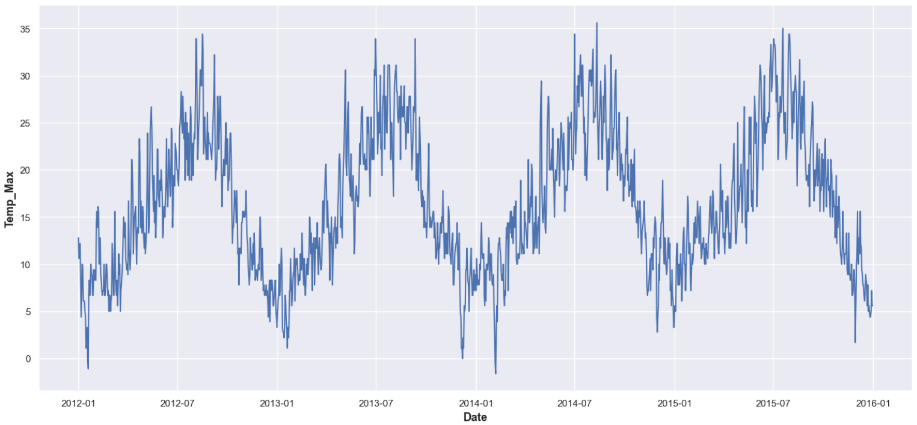
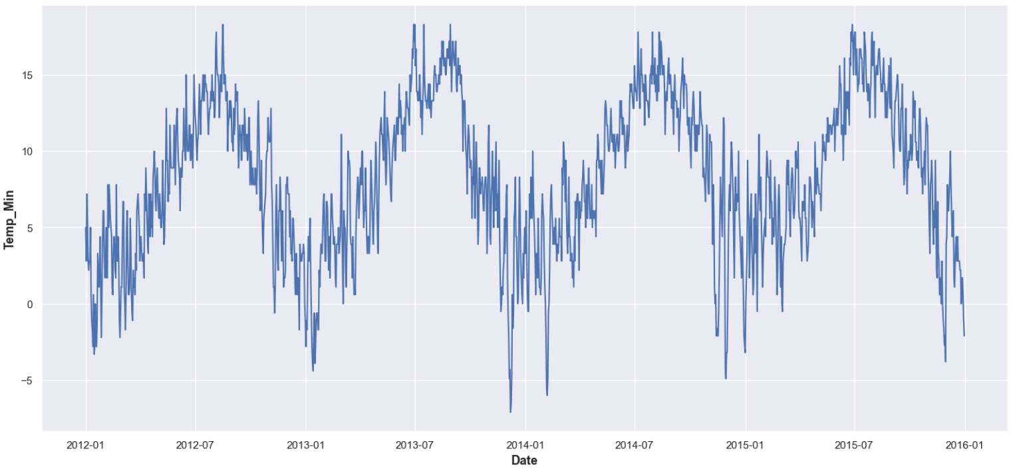
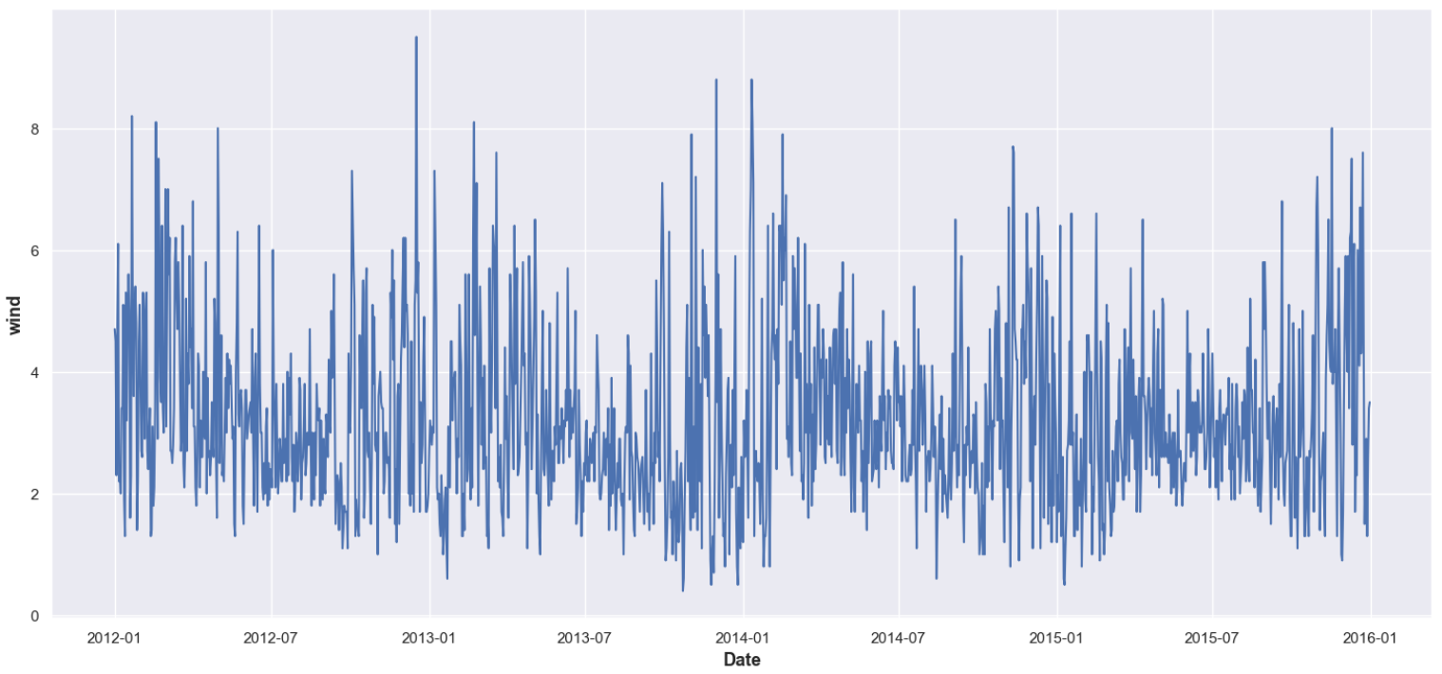
DATA VISUALIZATION
Line plot: The line plots display how parameters such as max-temperature, min-temperature, and wind speed vary over time, showing trends and fluctuations for each weather attribute across the given dates.

Slide 11
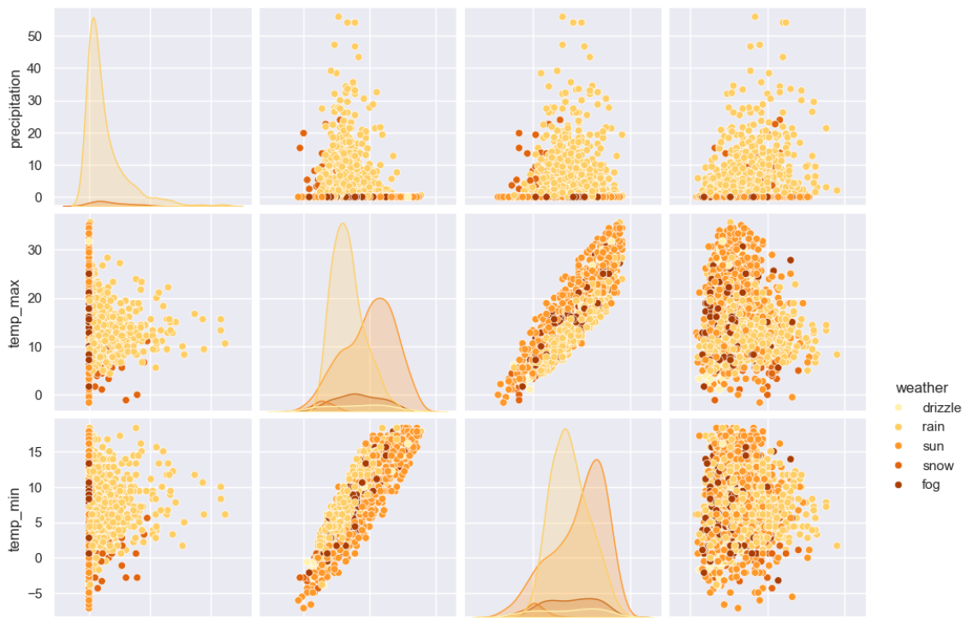
DATA VISUALIZATION
Pair Plot: The pair plot visualizes the relationships between multiple variables in the dataset (excluding date), with different weather conditions (weather) represented by different colors, allowing you to observe how features like temperature and wind vary with respect to weather types.

Slide 12
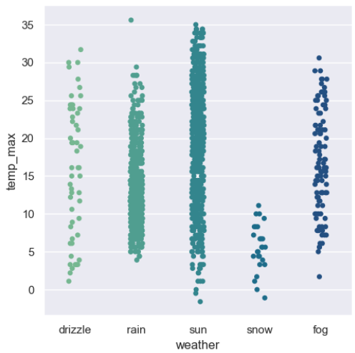
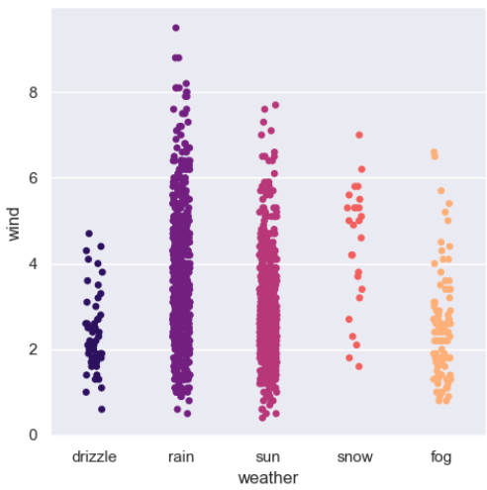
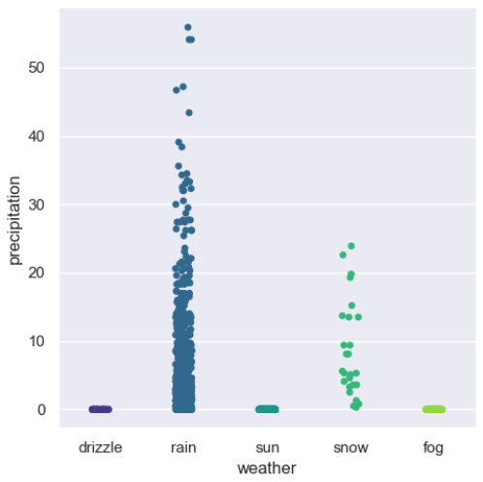
DATA VISUALIZATION
Cat Plot: The cat plot is used here to visualize the relationship between categorical (weather) and continuous variables (such as temp_max, temp_min, wind, and precipitation). It helps to compare the distribution and trends of these continuous variables across different weather conditions.

Slide 13
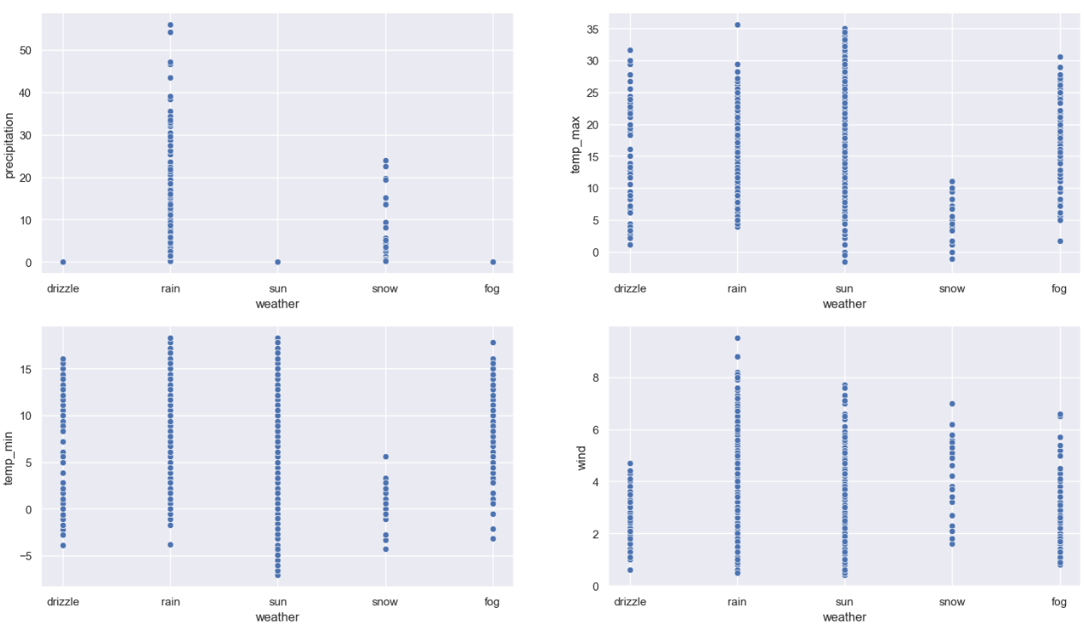
DATA VISUALIZATION
Scatterplot: The scatter plots display the relationships between weather (categorical) and various numerical variables (precipitation, temp_max, temp_min, and wind), allowing you to observe how each weather condition correlates with these factors.

Slide 14
MODELLING
Importing necessary Libraries
Train Test Split
Model Training
Model Prediction
Standard Scalar
Confusion Matrices
Logistic Regression
Support Vector Machine (SVM)
K-Neighbors Classifier
Decision Tree Classifier
Random Forest
Naïve Bayes
XG Boost
Model Evaluation Metrics

Slide 15
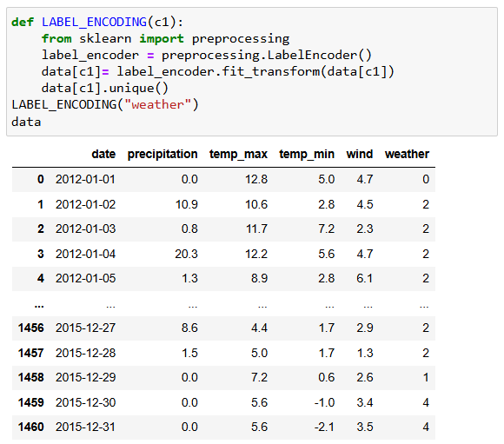
LABEL ENCODING
The weather data is being encoded into numbers for easier model evaluation.

Slide 16
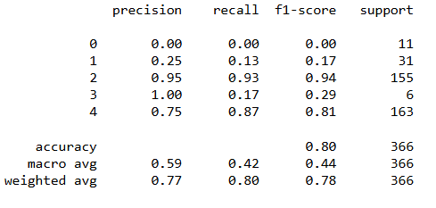
MODEL EVALUATION METRICES

Slide 17
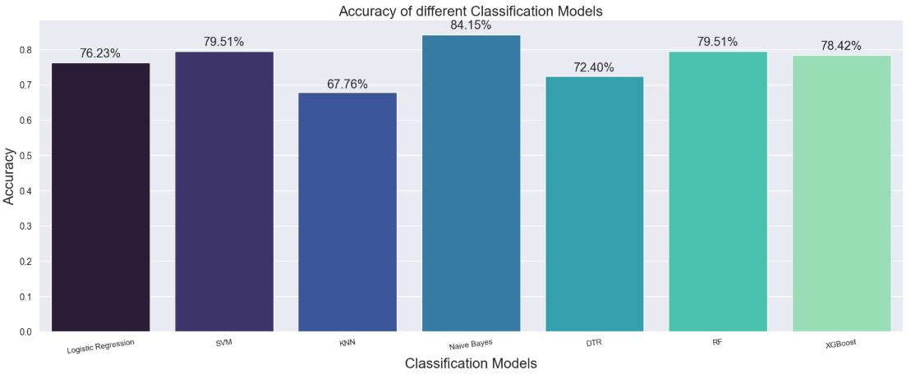
ACCURACY OF DIFFERENT MODELS

Slide 18

CONCLUSION
This project aims to enhance the understanding of weather prediction by applying data analysis techniques. The insights gained from this analysis will provide valuable information to many industries, aiding in the development of more effective management in decision making .

Slide 19


